Slide 1
PALAC 2022 Global Climate Change Research and the Liberal Arts Anthropocene Studies at HKBU
Kwai-Cheung LO
Hong Kong Baptist University

Slide 2
Anthropocene Studies Anthropocene Studies is one of the Arts Faculty Niche Research Areas. Using the geological term “Anthropocene” which designates significant human impacts on ecosystems, our research group aims to examine how humanities such as philosophy, literature, cinema, and arts respond to climate change, environmental politics, human-nature interactions, interspecies relationships, global competition for resources, effects of fossil fuel consumption on the Earth as well as other related socio-cultural transformations.

Slide 3
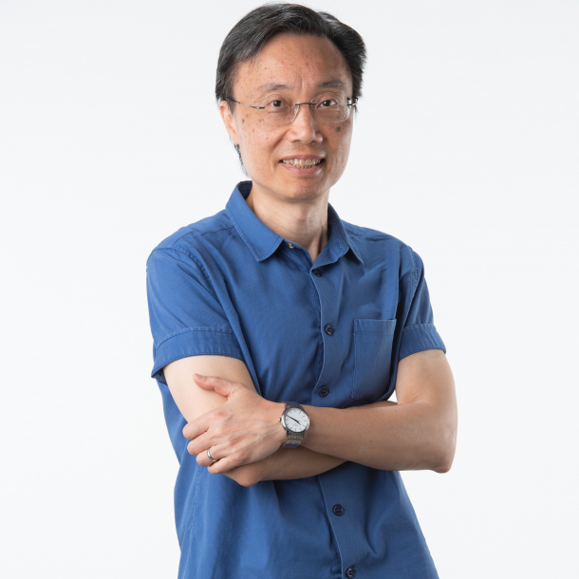
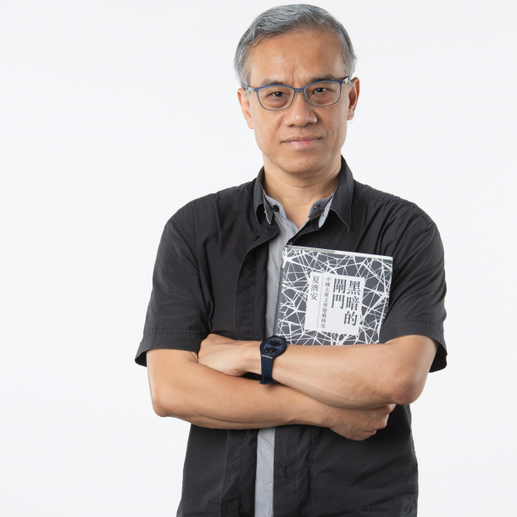
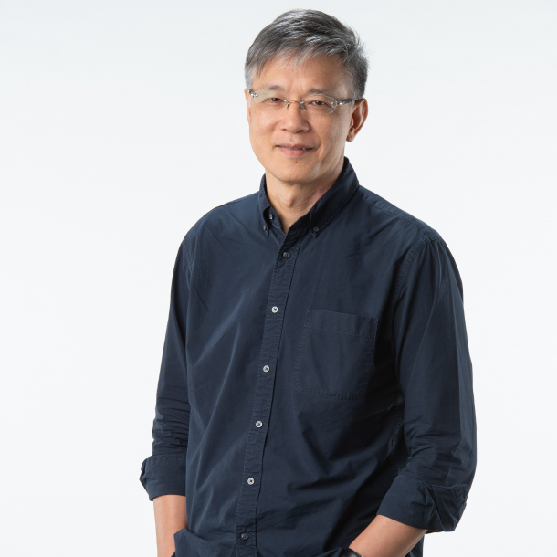
WHO ARE WE?
Prof Kwai-Cheung Lo, Head of Department of Humanities and Creative Writing (anchor)
Dr Jessica Yeung, Department of Translation, Interpreting and Intercultural Studies (co-anchor)
Dr Howard Choy, Department of Chinese Language and Literature
Dr Wai-ping Yau, Department of Translation, Interpreting and Intercultural Studies
Dr Emily Zong & Dr Dorothy Tse, Department of Humanities and Creative Writing; Dr Jason Lee, Department of English
With partners from other faculties, and local and international universities as well as postgraduate students

Slide 4
WHAT DO WE STUDY?
• Humanity in the environment
• Human understanding and representation of what is happening to the environment
• What Humanities Studies can do in the present state of the environment
• With a demographic focus on the Sinophone regions, but not restricted to them

Slide 5
WHAT ARE WE WORKING ON?
2 ongoing externally funded GRF projects:
Minority, Ethnicity, Environmental Cinema in China: In Search of Different Imaginaries of Ecological Civilization (Prof K.C. Lo)
Literature in the Time of Coronavirus: Online Diaries by Chinese Women Writers from Wuhan and New York (Dr Howard Choy)
1 ongoing internally funded FRNA project:
History and Translation: A Uyghur/Turki and Chinese Corpus (Dr Jessica Yeung)
1 Book Series published by Brill:
African and Asian Anthropocene (Dr Howard Choy as series chief editor)

Slide 6
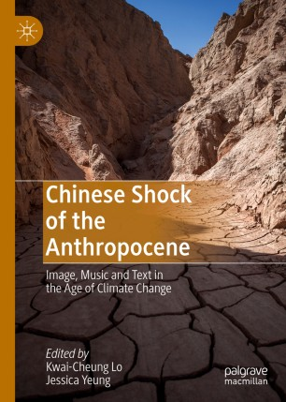
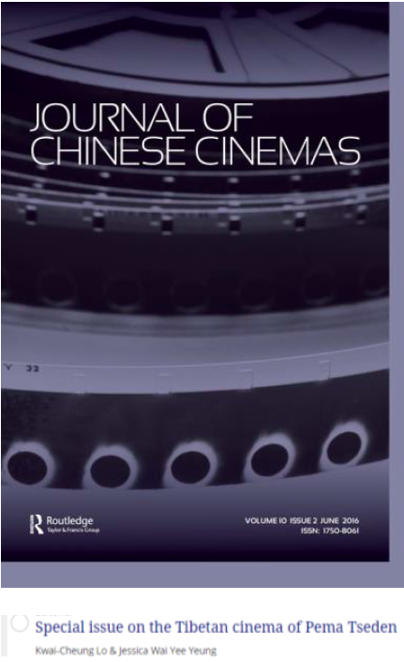
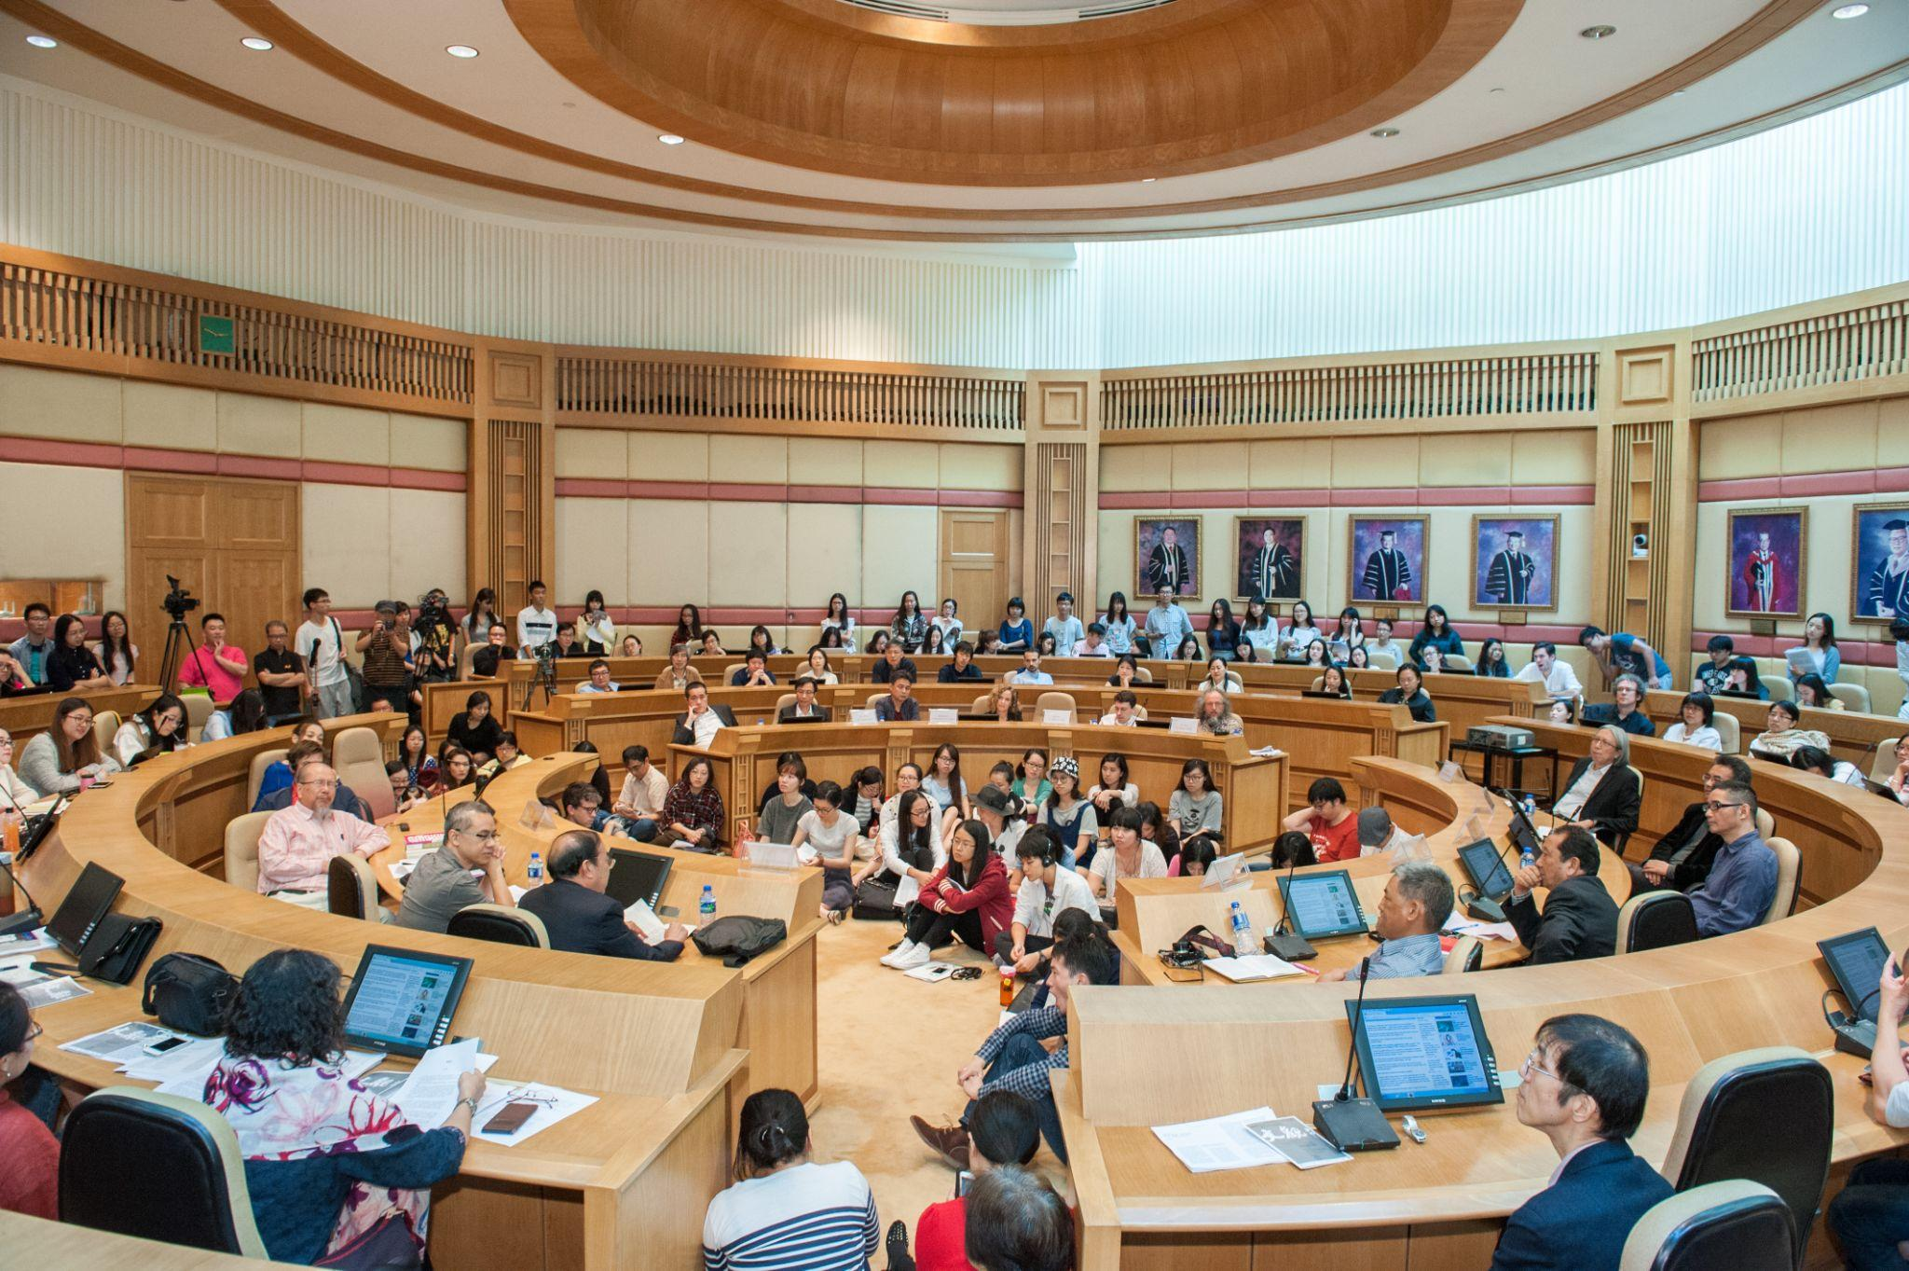
WHAT HAVE WE DONE SO FAR?
7 international academic conferences
1 essay collection
1 journal special issue
1 film collection with 200 films

Slide 8
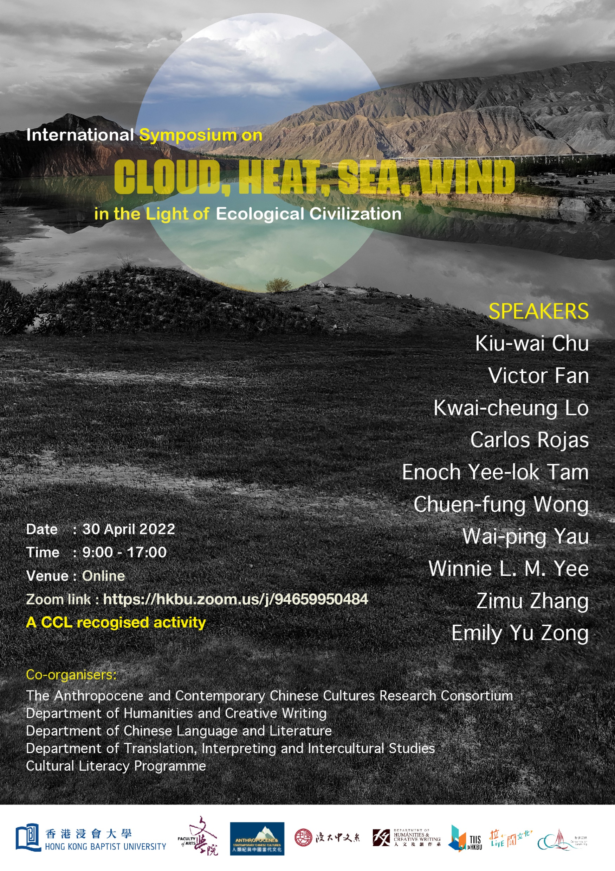
Program on 30 April (Saturday) Hong Kong Time
9 am Welcome and Introduction
Panel 1: Activism, Exoticism, and Multispecies Imaginations
Moderator: Kwai-cheung Lo
9:05 am (9:05 pm, Friday, East Coast Time) Carlos Rojas, “An Ecological Analysis of Environmental Activism in China”
9:25 am (8:25 pm, Friday, Central Time) Chuen-Fung Wong, “Rethinking the Nature in China’s ‘Minority’ Musical Exoticism”
9:45 am Emily Yu Zong, “Of Meat, Plant, and Soil: Multispecies Imaginations of Hong Kong”
10:05-10:35 am Discussion
Panel 2: Air, Wind-Water, Sound, and Space in Ecological Crisis
Moderator: Howard Yuen-fung Choy
11:00 am Winnie L.M. Yee, “Breathing and Singing in the Air: Some Preliminary Thoughts on Literary and Visual Narratives of Air in Post-socialist China”
11:20 am Kiu-wai Chu, “Feng Shui and the Civil Alternative Eco-civilisation: Geomancy and Ecology in Chinese Cinema”
11:40 am Enoch Yee-lok Tam, “The Sound Ecology in Hong Kong Ethnographic Documentaries”
12:00 noon Wai-ping Yau, “Chinese SF in the Anthropocene”
12:20 – 1: 00 pm Discussion
Panel 3: Governmentality and China’s Ecological Civilization
Moderator: Jessica Yeung
3:30 pm (9:30 am, Central Europe Time) Zimu Zhang, “Green Elegies: Ecofeminist Reading of Toxicity and Trauma in the Making of Chinese Ecological Civilization”
3:50 pm (8:50 am, UK Time) Victor Fan, “Ecology: From Governmentality to Interdependencies”
4:10 pm Kwai-Cheung Lo, “China’s Cloud Control in the Shadows of Ecological Civilization”
4:30-5:00 pm Discussion

Slide 9
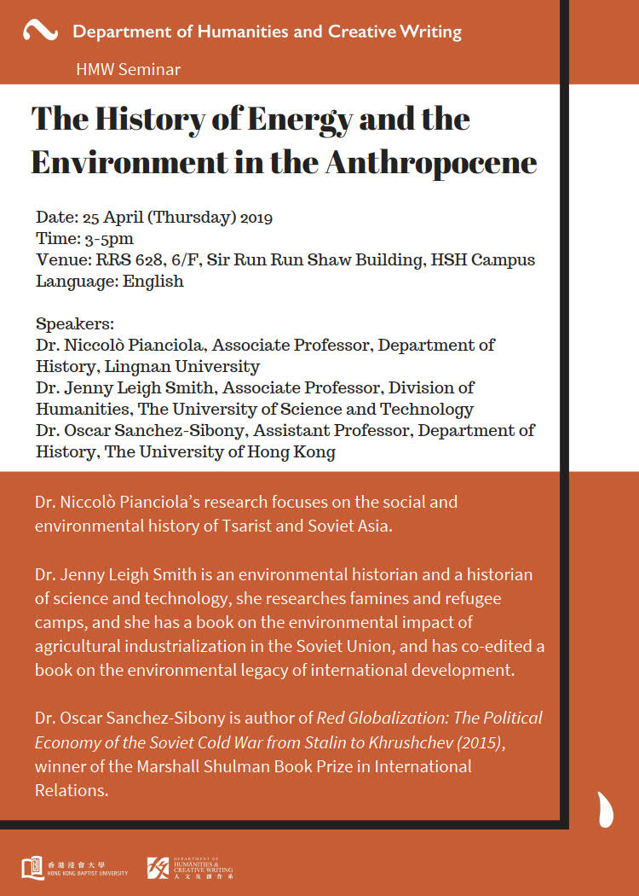
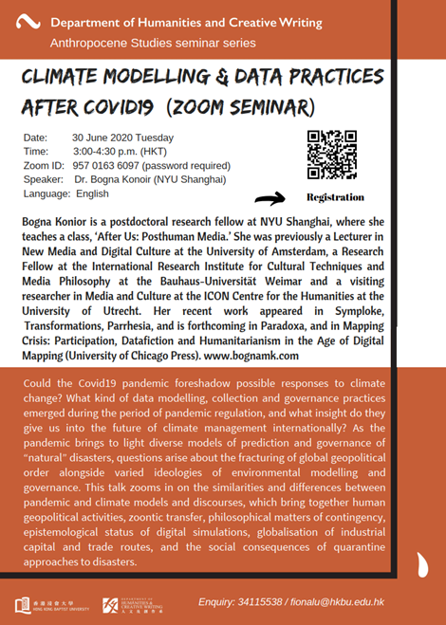
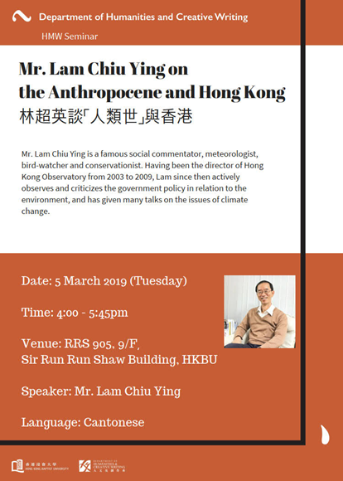

Slide 10
Curriculum Development for Undergraduate Students
Some new courses offered under the category of “Health and Environmental Humanities”:
Environmental Humanities: Key Concepts
Climate Change Literature and Culture
Health and the Humanities
Posthuman Futures
Disability, Culture & Technology

Slide 11
HOW DO WE MAKE IMPACT IN COMMUNITY?
80 film screenings with “meeting the director” in art venues and cinemas
1 film festival “focus on director”
1 public lecture at Asia Society
1 special issues in a Hong Kong flagship literary magazine
1 website and 2 social media channels
Numerous newspaper articles and media interviews
Future Plan: Workshop with High School Students in the summer

Slide 12
WHAT DO WE DO WITH NON-LOCAL PARTNERS?
Joint conferences and events with:
King’s college, London
Columbia University, New York
Hankuk University of Foreign Studies, Seoul
Agnes Scott College, Atlanta
Soochow University, Suzhou

Slide 13
Some of my recent related research topics:
Ecologizing Ethnic Minority Cinema in the Chinese Nation-Building Process
China’s Distant Water Fishing Fleet and the Overfishing Issue
Water Supply and Management in Hong Kong-China Relationship during the British Colonial Era
Cloud Control: Weather Modification Program and Cloud Computing Industry in the Shadows of China’s Ecological Civlization

Slide 14
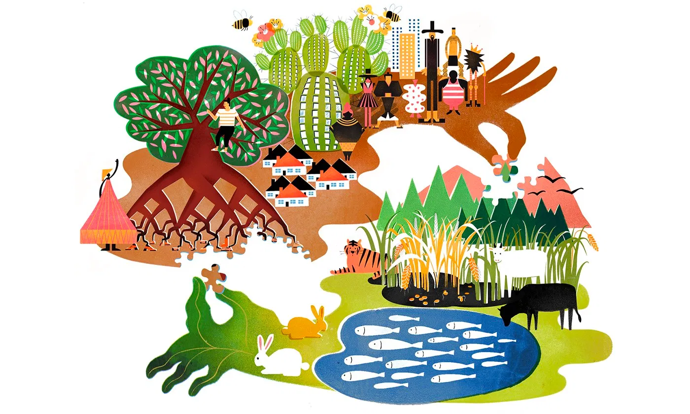
China’s Cloud Control in the Shadows of Ecological Civilization
Kwai-Cheung LO

Slide 15
China’s Geoengineering : weather modification programs
For decades, China has been investing heavily in this technology, resulting with owning one of the world’s most advanced weather modification programs
However, the efficacy of cloud seeding, rainmaking, rain-suppression, or hail-suppression remains undetermined
The State Council has announced in late 2020 to launch an extensive scheme to expand its rainmaking capabilities to cover sixty percent of the country’s territories by 2025

Slide 16
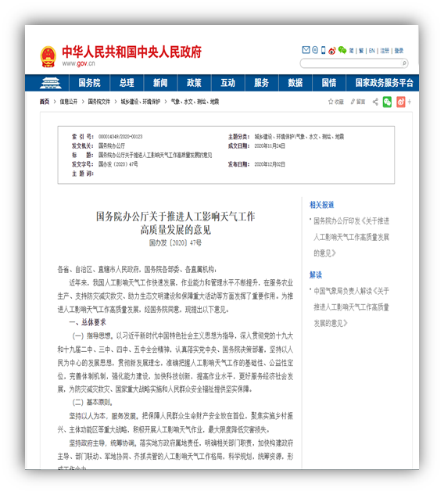
Weather modification seems only a modest and inexpensive program with limited social consequences
Chinese goals of the weather modification has for long been restrained: getting more precipitation in arid areas, reducing hail destructive to farming field, and ensuring blue sky in significant national events
Beijing’s ambition to weather the weather even only within its territorial sovereignty inevitably arouses the suspicions from its neighboring countries
The absence of proper international coordination of weather modification activity, even if confined to be domestic, could lead to “charges of rain stealing between neighboring regions”

Slide 17
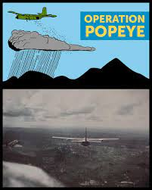
Weaponizing Weather
The American military has heavily supported the development of weather sciences for meteorological research after WWII
In the Vietnam War, the White House was actively involved in directing the secret mission in cloud seeding over the Ho Chi Minh Trail in order to flood the communist supply route
Climate geoengineering, which is mainly defined as the technology of removing carbon dioxide from the atmosphere, is getting its momentum in the twenty-first century
Some argues that it is technologically easy to stop global warming by injecting reflective particles of sulphuric acid into the upper atmosphere where they would scatter a fraction of incoming sunlight back to the space, creating a sunshade for the earth beneath
Uncertainties about the potential side-effects and the practical deployment of such specialized aircrafts and dispersal methods

Slide 18
China’s geoengineering endeavours do not only reveal the authorities’ plans to control the clouds in order to regulate the weather, but also their desire to take the form of the clouds by assuming a privileged, transcendent vantage point up in the sky over the world
A fantasy of political elites who want to play god by seeing the world in its entirety objectively, understanding the real and explaining all
By no means is the desire to be the clouds up above confined to authoritarian regime

Slide 19
The state-led ecological civilization project is meant to monopolize and control the discourse and discussion of China’s environmental issues while unintentionally generating new kinds of ecological imaginary from its highly repressed and censored civil society
Even though ecological civilization endeavours to maintain the impossible balance and reconcile tensions between unending economic growth and environmental protection, the burdens economic development imposes on ecology may overturn the official discursive description of “harmony” and heighten the social expectations for transformations of the status quo

Slide 20
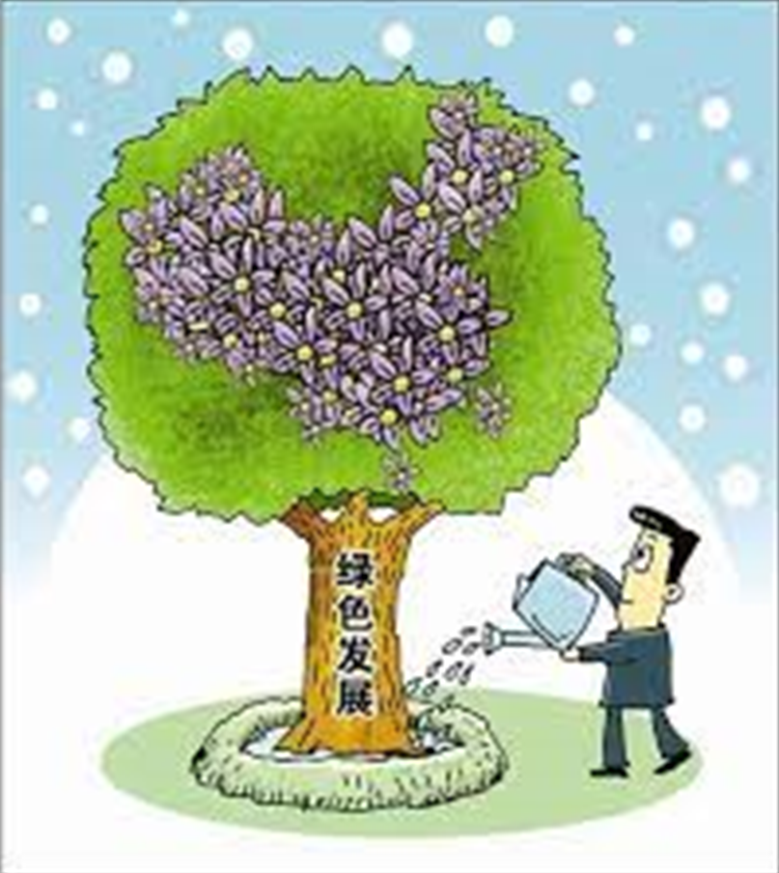
a primarily home-grown idea of sustainable growth, appears as a top-down model built upon the socialist ideologies with the emphasis on the mutual compatibility of economic growth, environmental sustainability, social justice and quality of life
The idea has been introduced to Chinese society through local government and NGO projects as well as academic discussions
In 2018, the Chinese Communist Party (CCP) wrote the goal of building an ecological civilization in the national constitution as the guiding principle for its development

Slide 21
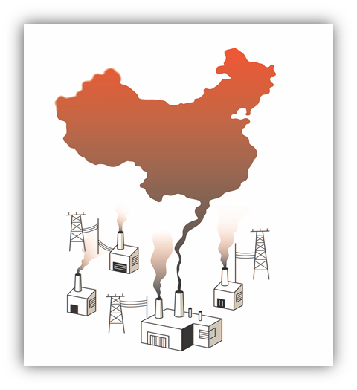
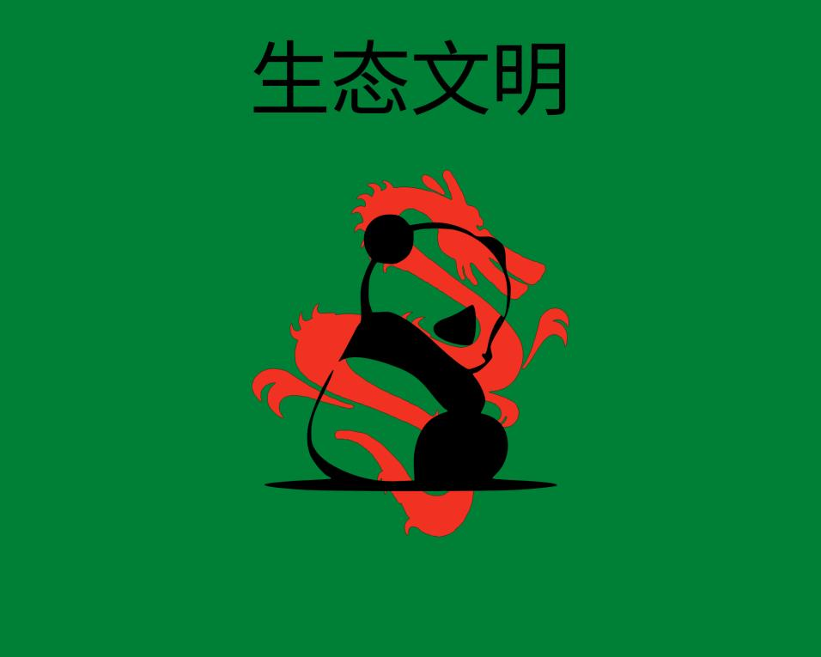
The state-led ecological civilization campaign remains predominantly a top-down, nontransparent, and non-participatory project that single-mindedly pursues the stipulated objectives and may possibly create second-order problems and unintended consequences
Because relatively little consultation has been done with local communities and the existing hierarchies reproduce urban-rural disparities as well as reinforce inequalities between central state powers and marginalized ethnic minorities
As the regime’s legitimacy primarily depends on its economic performance, ruling elites who are not directly held accountable to the society could still be constrained in its ecological governance when its sustainability objectives have to succumb to political mission of continuously creating wealth
The contradictory priorities and different goals are usually in conflict.

Slide 22
The image of the clouds is also manifested in China’s determination to monitor the cloud computing industry
For competitive and governance reasons, Beijing is eager to bolster the capabilities of Chinese cloud companies, not only the big firms like Alibaba Cloud, Huawei and Tencent, but also some unknown newcomers, such as Baosight, Maxscend, Sangfor, Supcon, or YoueData
New investment and migration have been reoriented from wealthy coastal cities to poorer interior landlocked provinces where the state is heavily nourishing and subsidizing thousands of new tech companies focusing on A.I., cloud computing and robotics
Cracking down on the tech giants recently in order to assert the supremacy of the CCP and to redistribute wealth for his common prosperity campaign, Xi also aims at moving away from soft tech development and producing China’s home-grown hard technologies for achieving self-sufficiency from the unfriendly Western world

Slide 23
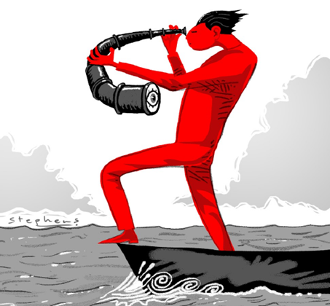
China shows strong signs of inward looking and of leaving behind its successful collaborative model with foreign companies that bring in capital and high tech gears over last three decades
The inward orientation of hi-tech development in China may reflect how the nation-state envisions to establish an alternative to the post-war Western, liberal global order and to carve up the world into different spheres of influence
it seems to be the dream of an authoritarian state to become an isolated cloud over its sphere of influence, if put it metaphorically. An isolated cloud is named cumulus.
Cumulus clouds are detached, individual, cauliflower-shaped clouds often described as puffy or cotton-like and usually spotted in fair weather conditions
But cumulus clouds won’t remain detached for long. They can later develop into towering clouds accompanying with powerful thunderstorms

Slide 24
The association of clouds with freedom, mobility, unrestricted circulation and interconnection also camouflages the operation of cloud computing.
Cloud computing is a kind of computation that covers up the distinction between software and hardware by naturalizing the computer as integral part of the environment
While cloud computing promises the dematerialization of data storage and the ubiquitous connectivity of frictionless computation in all spaces, its nature and infrastructure cannot be obfuscated as shapeless, amorphous clouds but remains as stratified grid-network constructions and data hubs at some real locations that require immense amounts of power to keep them running and are simultaneously emitting carbon dioxide.

Slide 25
However, such atmosphere control also runs into another paradox. In order to monitor and screen the information flows in the nation’s digital networks, all messages sent on China’s platform, for example, WeChat, the most widely used messaging application, are required to pass through central servers unencrypted so that authorities can filter and censor them according to the official criteria.
Such mandate makes those servers weak in security and vulnerable to any foreign intelligence agency that wants to spy on Chinese citizens.
As the Chinese (digital) surveillance system is an entrenched mechanism built on censoring and monitoring its own people, the contradiction between security against enemies within and those without will prolong.
The more the operation of the authoritarian state relies on the security weakness in its civil society, the harder the existing loophole can be fixed or removed
An efficient cloud system enables China’s surveillance mechanism and digital security function seamlessly and creates an all-round atmospheric power control.

Slide 26
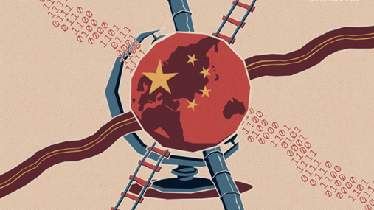
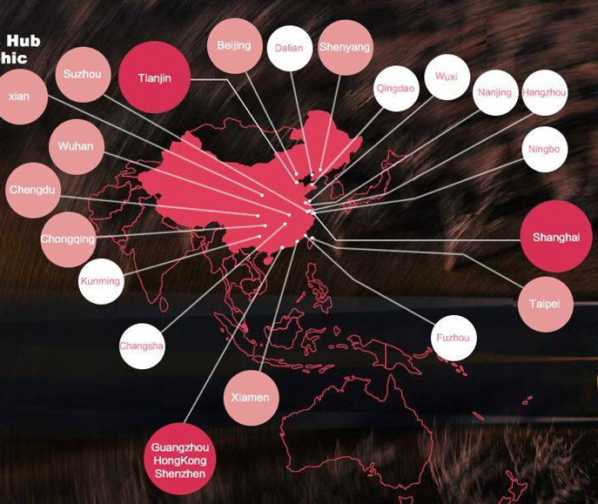
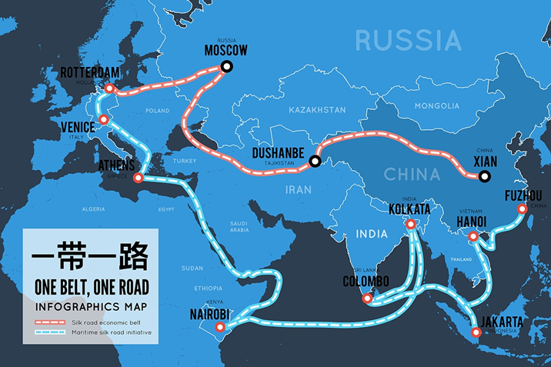
The cloud image eliminates the representation but not the existence of the grid-structure of computation
It may be true that the ruling elites do want to associate with the cloud image in order to emphasize their celestial power and privilege, but at the same time they also like to foreground the grid they have built on the ground so as to glorify the magnificent infrastructure that has united the big nation and reconfigured the world as a network or a web of connectivity in which China becomes the central hub.
The infrastructure refers to China’s three-decade infrastructure investment and urbanization boom and the Belt and Road Initiative.
But these mega construction projects have also created their own serious problems, like the environmental risks that undermine the ecological civilization campaign. Many of these infrastructure investments are neither productive or well managed, becoming a drag to the economies of China and other nations participating in the BRI

Slide 27
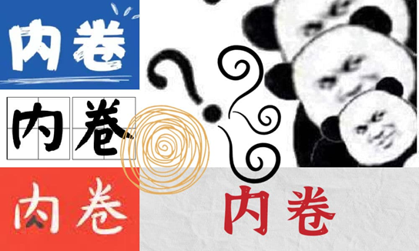
China serves as a good model, not only given its sheer size, growth rate and volatile situation, to examine how the combination of geoengineering and digital technologies impacts on cloud control
Clouds could mean both connection and isolation, as if China wants global trade and economic self-sufficiency at the same time. President Xi has vigorously promoted the mechanism of double circulation, while it may have risks to become inner loop (nei xunhuan) or even involution (neijuan)
But involution does not mean failure, from the perspective of control. Because it is a situation where new input has been brought in but there are no real changes in social structure and the same pattern or cycle continues.
Etymologically, control means stopping the roll or the wheel. Hence, stagnation may imply the success of control
As long as there’s no way to stop cloud rolling, control can never succeed but is self-motivated to perpetuate

